Slide 1
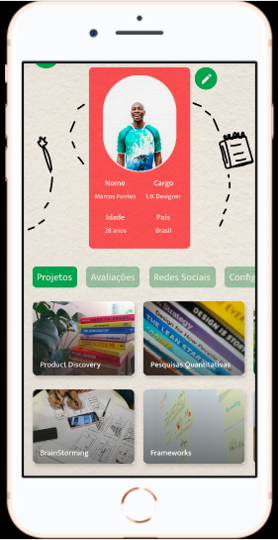
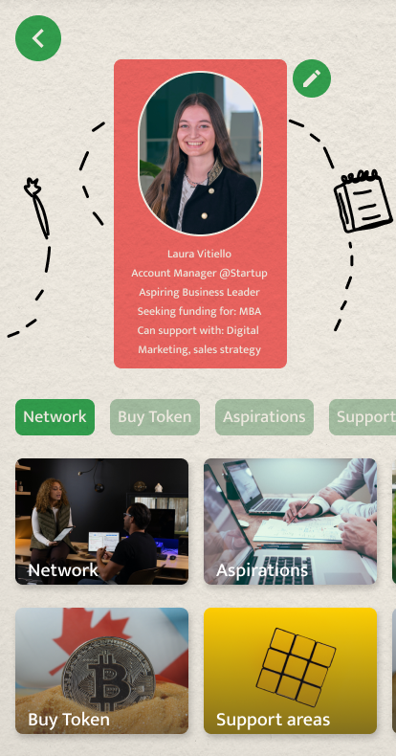
ConneX
Connect to empower

Slide 2
Agenda
01
Trigger
03
Business Model
02
Concept
04
Go-to-market Strategy
05
Founding Team

Slide 3

The Trigger
Talent is distributed evenly
– Opportunities are not

Slide 4
ConneX
Lack of vitamins -> Supplements
Lack of access to opportunities -> ConneX
How?
Promoting Lifelong learning through redistribution of talent & opportunities
Leverage Swift Edu data for matching between students & investors through Blockchain Technology

Slide 5


> 3.000.000 CHF
“
Ensure inclusive and equitable quality education and promote lifelong learning opportunities for all.
”
165,000
Current University Students
Money Spent on Recruitment of Students
Notes:
Millionairs: https://de.statista.com/statistik/daten/studie/945432/umfrage/millionaere-in-der-schweiz/
Students total: https://de.statista.com/statistik/daten/studie/289737/umfrage/anzahl-der-studierenden-an-oeffentlichen-hochschulen-in-der-schweiz/
Students new: https://de.statista.com/statistik/daten/studie/307379/umfrage/studieneintritte-an-universitaeten-in-der-schweiz-nach-studienstufen/
Cost per Hiring:https://resources.workable.com/tutorial/faq-recruitment-budget-metrics
Assumtion: 10% on activities
Hires from Uni per year: 10.000

Slide 6
ConneX Prototype

Slide 7
The Concept - Student perspective
1
3
5
Create your Profile through Switch Edu sync
(Possibly) provide a service in return for the investment
Build long-lasting mentoring relationships out of your direct reach
2
4
Get noticed by external parties (individuals or companies) who
invest in you
Grow your token value as investments increase and you realise your potential

Slide 8
The Concept - Supporter perspective
1
3
Explore talents &
invest tokens
Expand your network intergenerationally
2
4
Access service(s) provided by student & get instant emotional return
Have an impact while receiving a return

Slide 9
The Concept - Corporate perspective
1
3
Explore talents & invest tokens
Expand your network intergenerationally
2
4
Create a pull of high potential individuals to fine tune in recruiting
Have an impact while receiving a return

Slide 10




Business Model
3% service fee
Corporates
ConneX
Mentees
Supporters
Mentees Turn to Mentors

Slide 11
Go-to-market Strategy
Switch Edu
University Network
Blockchain community
+
1
Alumni & Student Ambassadors
2
Making buzz with viral success stories
3

Slide 12
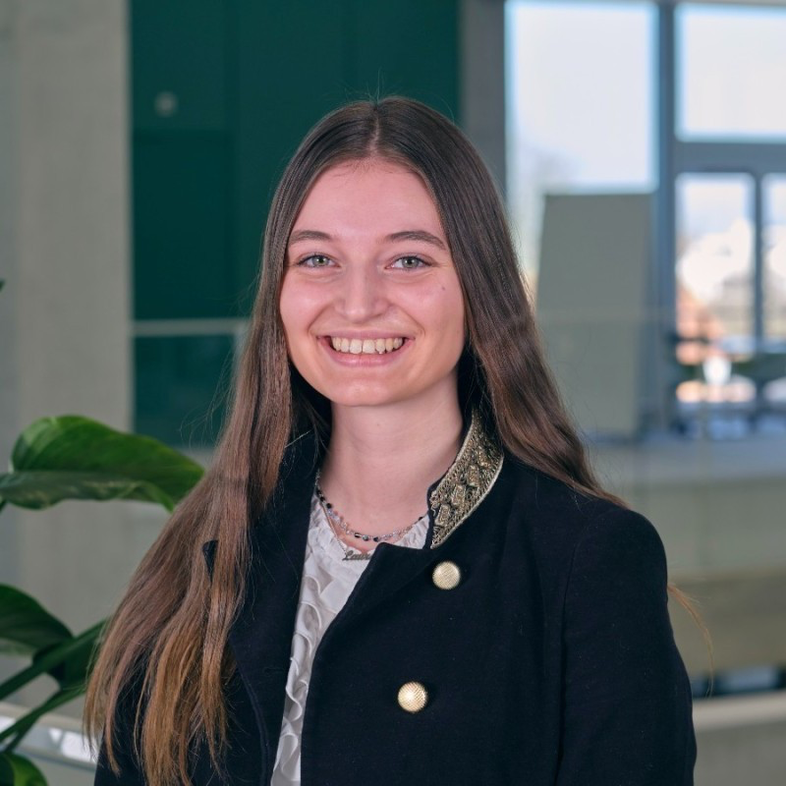
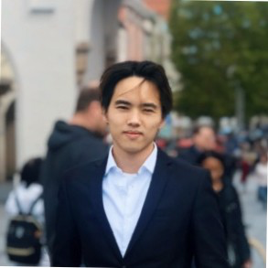
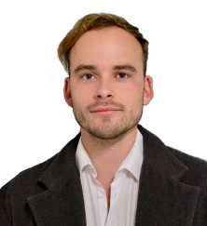

Founding Team
Laura Vitiello
Terence La
Vinzenz Duenschede
Felipe Fortes
MSc. CEMS MIM Double Degree Candidate at UoC & St.Gallen
Background in Business & Philosophy
MSc. CEMS MIM Double Degree Candidate at RSM & St.Gallen
Cofounder Edumi
M.A. HSG Business Innovation and Symposium Leader of Tomorrow
Founder, Growth Strategist
BSc. Economy & gestion UniverMantova
Founder
Eco Spring

Slide 13
Thank you
Any questions?

Slide 14
CREDITS: This presentation template was created by Slidesgo, including icons by Flaticon and infographics & images by Freepik

